Slide 1
Cluster Analysis
Module 5

Slide 2
Cluster Analysis groups objects based on information found in the data that describes the objects and their relationships
The goal is that the objects within a group be similar to one another and different from the objects in the other groups

Slide 3
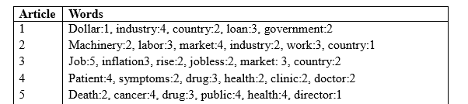

Slide 4
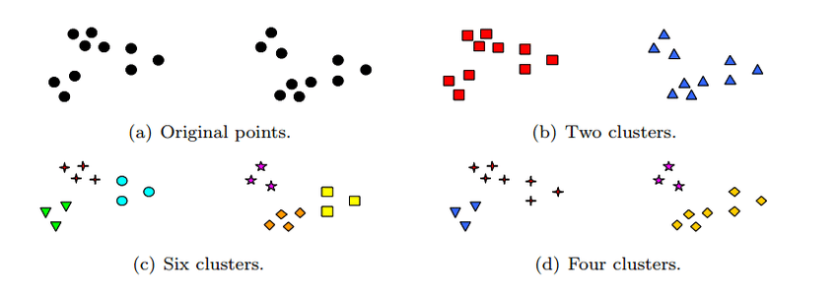

Slide 5
The k-means method:
Also called the centroid method since at each step the centroid point of each cluster is assumed to be known
The k-means method uses the Euclidean distance measure
If Instead of Euclidean distance measure, the Manhattan distance is used then the method is called the k-median method

Slide 6
The K-means method is described as follows:
Select the number of clusters. Let this number be k
Pick k seed as the centroid of the k-cluster. Seed may be picked randomly
Compute the distance of each object in the data set from each of the centroids
Allocate each object to the cluster it is nearest to based on the distances computed in the previous step
Compute the centroid of the cluster by computing the means of the attribute values of the object in each cluster
Check if the stopping criteria has been met (ex. If the cluster membership is unchanged). If yes go to step7 . If no go to step3.
Stop

Slide 7
STUDENT | AGE | MARK 1 | MARK 2 | MARK 3
S1 | 18 | 73 | 75 | 57
S2 | 18 | 79 | 85 | 75
S3 | 23 | 70 | 70 | 52
S4 | 20 | 55 | 55 | 55
S5 | 22 | 85 | 86 | 87
S6 | 19 | 91 | 90 | 89
S7 | 20 | 70 | 65 | 60
S8 | 21 | 53 | 56 | 59
S9 | 19 | 82 | 82 | 60
S10 | 47 | 75 | 76 | 77

Slide 8
Step 1: let k=3( clusters)
Step 2: let seed be the first 3 students
STUDENT | AGE | MARK 1 | MARK 2 | MARK 3
S1 | 18 | 73 | 75 | 57
S2 | 18 | 79 | 85 | 75
S3 | 23 | 70 | 70 | 52

Slide 9
1- iteration(step 3 and 4)
C1 | 18 | 73 | 75 | 57 | Distance from cluster |  |  | Allocation to the nearest cluster
C2 | 18 | 79 | 85 | 75 | C1 | C2 | C3
C3 | 23 | 70 | 70 | 52
S1 | 18 | 73 | 75 | 57
S2 | 18 | 79 | 85 | 75
S3 | 23 | 70 | 70 | 52
S4 | 20 | 55 | 55 | 55
S5 | 22 | 85 | 86 | 87
S6 | 19 | 91 | 90 | 89
S7 | 20 | 70 | 65 | 60
S8 | 21 | 53 | 56 | 59
S9 | 19 | 82 | 82 | 60
S10 | 47 | 75 | 76 | 77

Slide 10
1- iteration(step 3 and 4)
C1 | 18 | 73 | 75 | 57 | Distance from cluster |  |  | Allocation to the nearest cluster
C2 | 18 | 79 | 85 | 75 | C1 | C2 | C3
C3 | 23 | 70 | 70 | 52
S1 | 18 | 73 | 75 | 57 | 0 | 34 | 18
S2 | 18 | 79 | 85 | 75
S3 | 23 | 70 | 70 | 52
S4 | 20 | 55 | 55 | 55
S5 | 22 | 85 | 86 | 87
S6 | 19 | 91 | 90 | 89
S7 | 20 | 70 | 65 | 60
S8 | 21 | 53 | 56 | 59
S9 | 19 | 82 | 82 | 60
S10 | 47 | 75 | 76 | 77

Slide 11
1- iteration(step 3 and 4)
C1 | 18 | 73 | 75 | 57 | Distance from cluster |  |  | Allocation to the nearest cluster
C2 | 18 | 79 | 85 | 75 | C1 | C2 | C3
C3 | 23 | 70 | 70 | 52
S1 | 18 | 73 | 75 | 57 | 0 | 34 | 18 | C1
S2 | 18 | 79 | 85 | 75
S3 | 23 | 70 | 70 | 52
S4 | 20 | 55 | 55 | 55
S5 | 22 | 85 | 86 | 87
S6 | 19 | 91 | 90 | 89
S7 | 20 | 70 | 65 | 60
S8 | 21 | 53 | 56 | 59
S9 | 19 | 82 | 82 | 60
S10 | 47 | 75 | 76 | 77

Slide 12
1- iteration(step 3 and 4)
C1 | 18 | 73 | 75 | 57 | Distance from cluster |  |  | Allocation to the nearest cluster
C2 | 18 | 79 | 85 | 75 | C1 | C2 | C3
C3 | 23 | 70 | 70 | 52
S1 | 18 | 73 | 75 | 57 | 0 | 34 | 18 | C1
S2 | 18 | 79 | 85 | 75 | 34 | 0 | 52 | C2
S3 | 23 | 70 | 70 | 52 | 18 | 52 | 0 | C3
S4 | 20 | 55 | 55 | 55 | 42 | 76 | 36 | C3
S5 | 22 | 85 | 86 | 87
S6 | 19 | 91 | 90 | 89
S7 | 20 | 70 | 65 | 60
S8 | 21 | 53 | 56 | 59
S9 | 19 | 82 | 82 | 60
S10 | 47 | 75 | 76 | 77

Slide 13
1- iteration(step 3 and 4)
C1 | 18 | 73 | 75 | 57 | Distance from cluster |  |  | Allocation to the nearest cluster
C2 | 18 | 79 | 85 | 75 | C1 | C2 | C3
C3 | 23 | 70 | 70 | 52
S1 | 18 | 73 | 75 | 57 | 0 | 34 | 18 | C1
S2 | 18 | 79 | 85 | 75 | 34 | 0 | 52 | C2
S3 | 23 | 70 | 70 | 52 | 18 | 52 | 0 | C3
S4 | 20 | 55 | 55 | 55 | 42 | 76 | 36 | C3
S5 | 22 | 85 | 86 | 87 | 57 | 23 | 67 | C2
S6 | 19 | 91 | 90 | 89 | 66 | 32 | 82 | C2
S7 | 20 | 70 | 65 | 60 | 18 | 46 | 16 | C3
S8 | 21 | 53 | 56 | 59 | 44 | 74 | 40 | C3
S9 | 19 | 82 | 82 | 60 | 20 | 22 | 36 | C1
S10 | 47 | 75 | 76 | 77 | 52 | 44 | 60 | C2

Slide 14
Step 5: Compute the centroid by computing the mean of the attribute values of the objects in each cluster
 | AGE | MARK 1 | MARK 2 | MARK 3
C1 | 18.5 | 77.5 | 78.5 | 58.5
C2 | 26.5 | 82.5 | 84.3 | 82
C3 | 21 | 62 | 61.5 | 56.5

Slide 15
2- iteration(step 3 and 4)
C1 | 18.5 | 77.5 | 78.5 | 58.5 | Distance from cluster |  |  | Allocation to the nearest cluster
C2 | 26.5 | 82.5 | 84.3 | 82 | C1 | C2 | C3
C3 | 21 | 62 | 61.5 | 56.5
S1 | 18 | 73 | 75 | 57
S2 | 18 | 79 | 85 | 75
S3 | 23 | 70 | 70 | 52
S4 | 20 | 55 | 55 | 55
S5 | 22 | 85 | 86 | 87
S6 | 19 | 91 | 90 | 89
S7 | 20 | 70 | 65 | 60
S8 | 21 | 53 | 56 | 59
S9 | 19 | 82 | 82 | 60
S10 | 47 | 75 | 76 | 77

Slide 16
2- iteration(step 3 and 4)
C1 | 18.5 | 77.5 | 78.5 | 58.5 | Distance from cluster |  |  | Allocation to the nearest cluster
C2 | 26.5 | 82.5 | 84.3 | 82 | C1 | C2 | C3
C3 | 21 | 62 | 61.5 | 56.5
S1 | 18 | 73 | 75 | 57 | 10 | 52.3 | 28 | C1
S2 | 18 | 79 | 85 | 75 | 25 | 19.8 | 62 | C2
S3 | 23 | 70 | 70 | 52 | 27 | 60.3 | 23 | C3
S4 | 20 | 55 | 55 | 55 | 51 | 90.3 | 16 | C3
S5 | 22 | 85 | 86 | 87
S6 | 19 | 91 | 90 | 89
S7 | 20 | 70 | 65 | 60
S8 | 21 | 53 | 56 | 59
S9 | 19 | 82 | 82 | 60
S10 | 47 | 75 | 76 | 77

Slide 17
2- iteration(step 3 and 4)
C1 | 18.5 | 77.5 | 78.5 | 58.5 | Distance from cluster |  |  | Allocation to the nearest cluster
C2 | 26.5 | 82.5 | 84.3 | 82 | C1 | C2 | C3
C3 | 21 | 62 | 61.5 | 56.5
S1 | 18 | 73 | 75 | 57 | 10 | 52.3 | 28 | C1
S2 | 18 | 79 | 85 | 75 | 25 | 19.8 | 62 | C2
S3 | 23 | 70 | 70 | 52 | 27 | 60.3 | 23 | C3
S4 | 20 | 55 | 55 | 55 | 51 | 90.3 | 16 | C3
S5 | 22 | 85 | 86 | 87 | 47 | 13.8 | 79 | C2
S6 | 19 | 91 | 90 | 89 | 56 | 28.8 | 92 | C2
S7 | 20 | 70 | 65 | 60 | 24 | 60.3 | 16 | C3
S8 | 21 | 53 | 56 | 59 | 50 | 86.3 | 17 | C3
S9 | 19 | 82 | 82 | 60 | 10 | 32.3 | 46 | C1
S10 | 47 | 75 | 76 | 77 | 52 | 41.3 | 74 | C2

Slide 18
Note that the clusters have not changed
Cluster 1 → c1→ s1, s9
Cluster 2 → c2→s2, s5, s6, s10
Cluster 3 → c3→s3, s4, s7, s8

Slide 19
Example 2
Following are the marks of students in a class:
10, 12, 15, 30, 32, 35
Seed1=10
Seed2=30

Slide 22
Different types of Clustering
Hierarchical clustering Vs Partitioning clustering
Exclusive vs Overlapping vs Fuzzy
Complete vs Partial

Slide 23
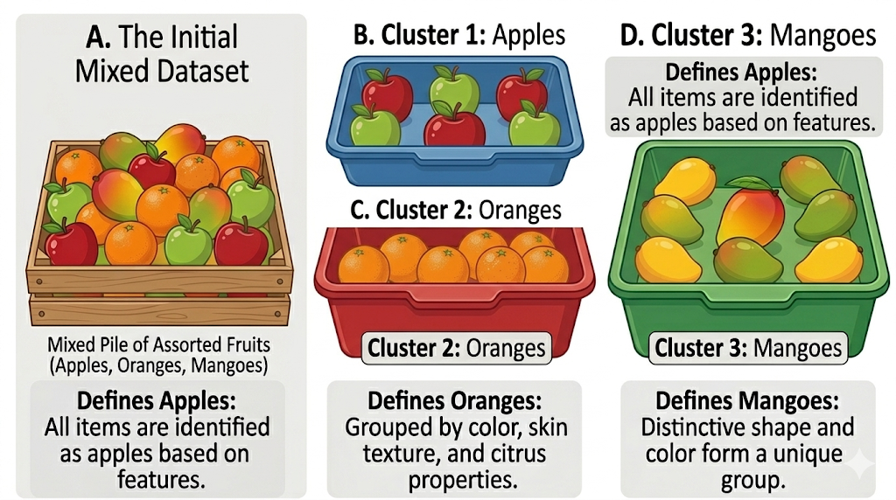
Partitioning clustering

Slide 24
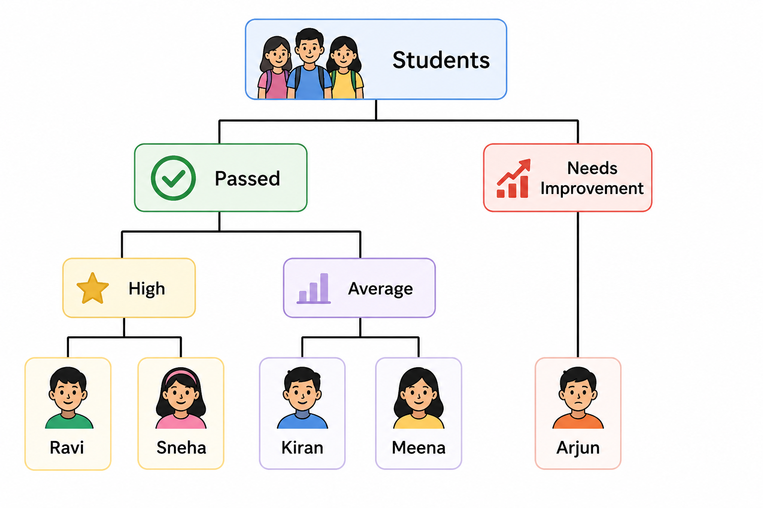
Hierarchical Clustering

Slide 25
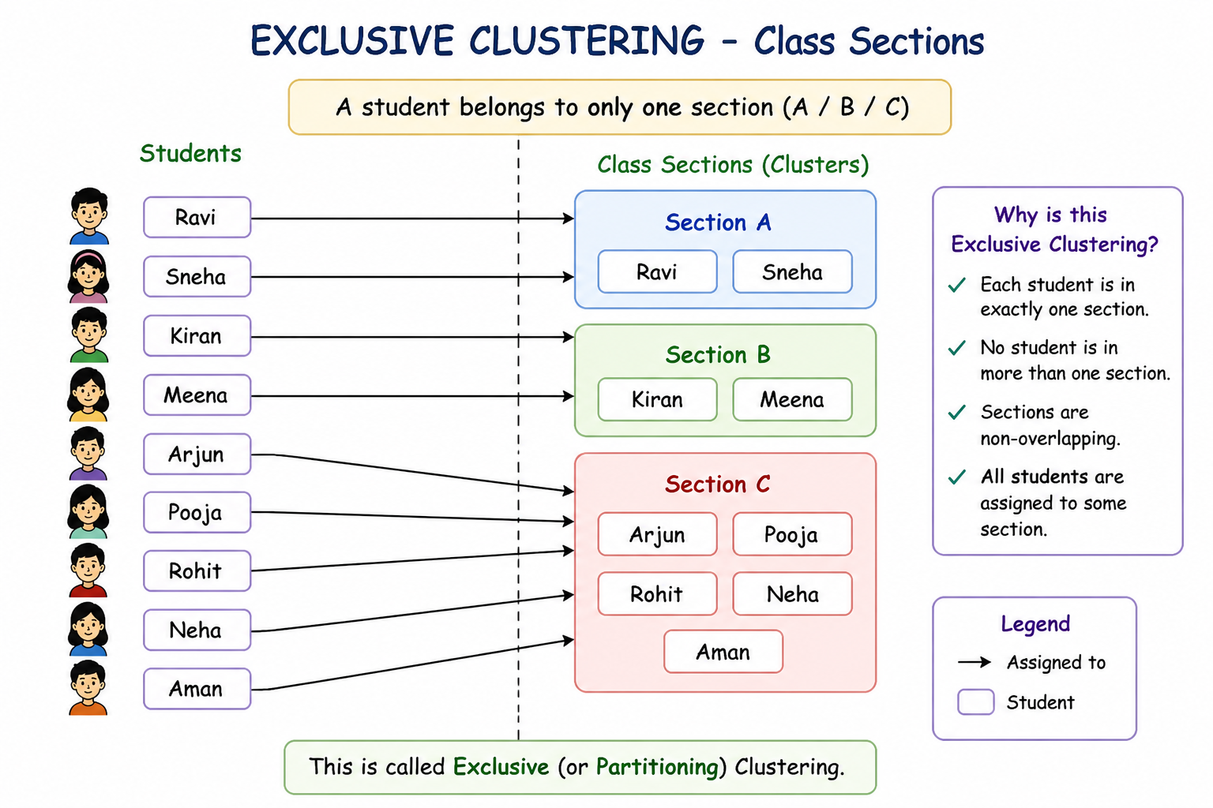
Exclusive Clustering

Slide 26
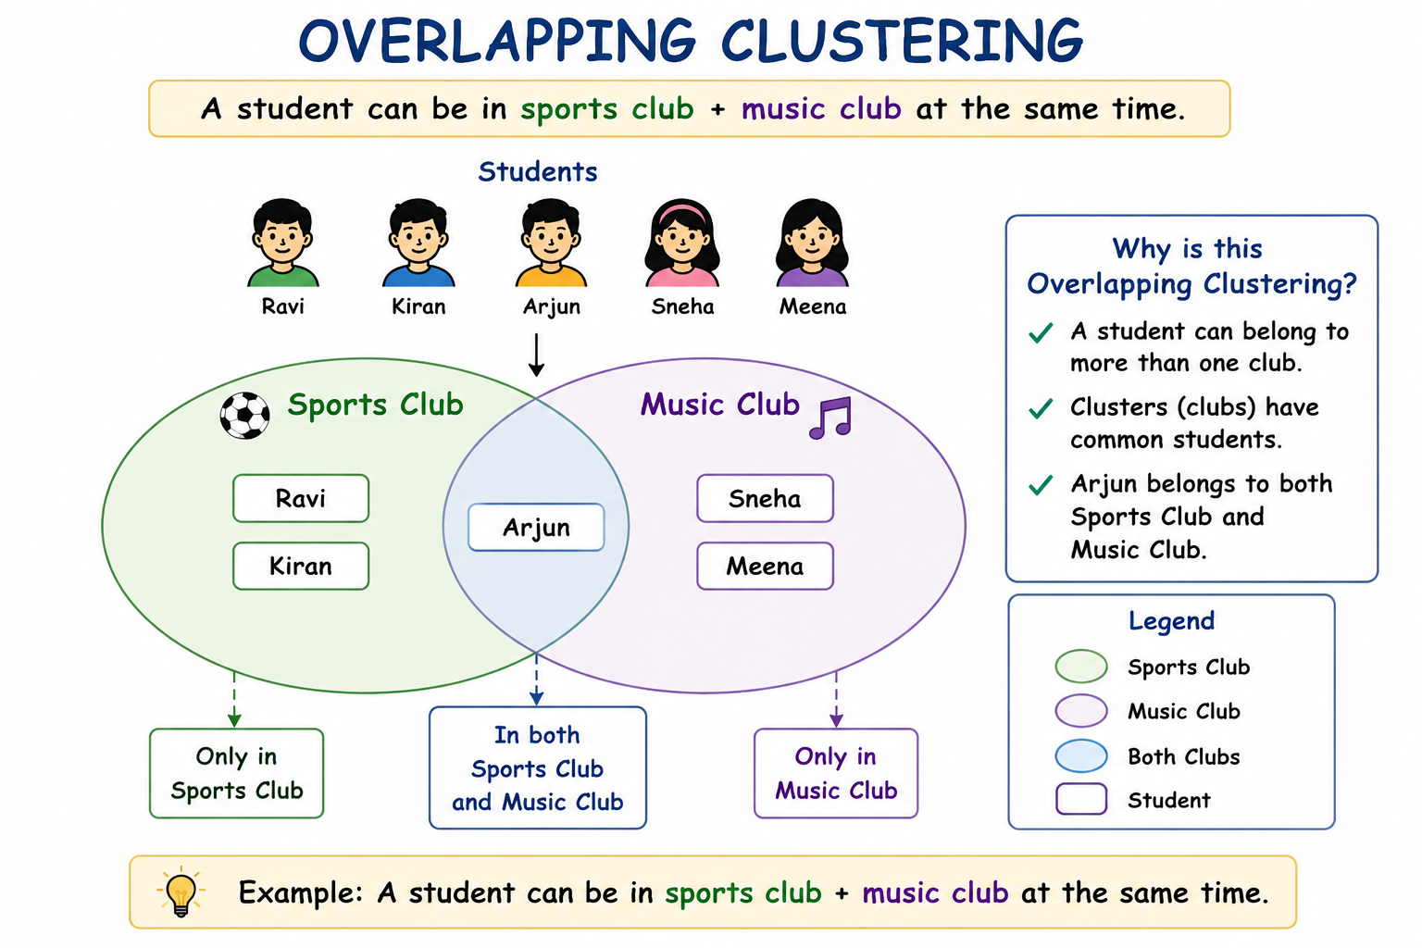
Overlapping Clustering

Slide 27
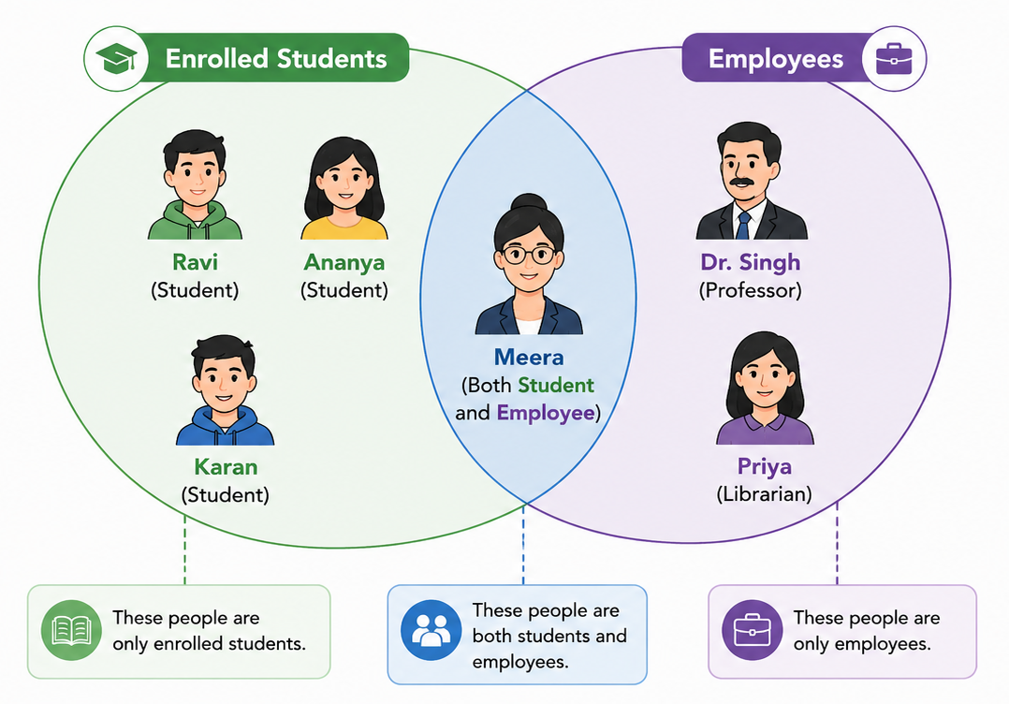
Example 2

Slide 28
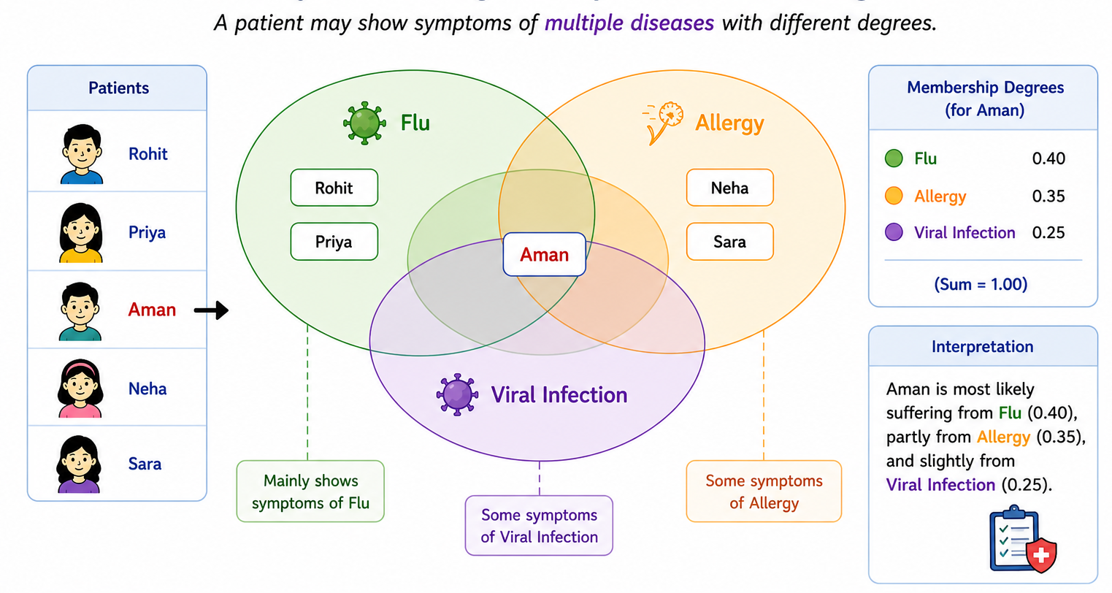
Fuzzy Clustering

Slide 29
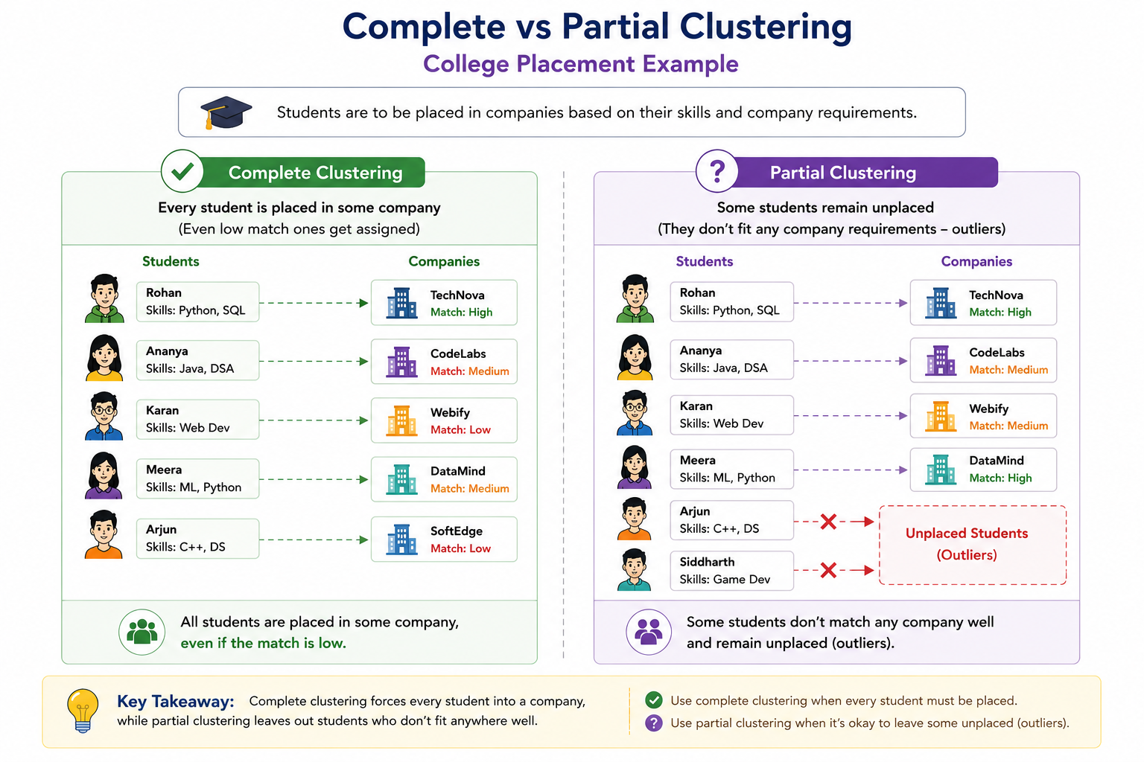
Complete Clustering

Slide 30
Partial Clustering

Slide 31
Partitioning clustering
Partitioning Clustering are clustering techniques that subdivide the data sets into a set of k groups, where k is the number of groups pre-specified by the analyst.

Slide 32
Hierarchical clustering
Hierarchical clustering is an alternative approach to partitioning clustering.
The result of hierarchical clustering is a tree-based representation of the objects
Each node(cluster) in the tree is a union of the children(sub clusters) and the root of the tree is the cluster containing all objects but leaf of the tree are single cluster of individual data objects

Slide 33
Exclusive vs Overlapping vs Fuzzy
In Exclusive clustering we assign each object to a single cluster.
There are many situations in which a point could reasonably be placed in more than one cluster and these situations are better addressed by Non-Exclusive clustering

Slide 34
Non-Exclusive clustering or overlapping clustering:
In Non-Exclusive clustering or overlapping clustering an object can simultaneously belong to more than one group(class)
Ex: A person at a university can be both an enrolled student and employee of university

Slide 35
Fuzzy Clustering:
Every object belongs to every cluster with membership weight that is between 0 and 1.
0- Absolutely does not belong
1- Absolutely belongs

Slide 36
Complete vs Partial:
A complete clustering assigns every object to a cluster where as partial clustering does not
Example: Some newspaper stories may have a common theme, while other stories are more generic

Slide 37
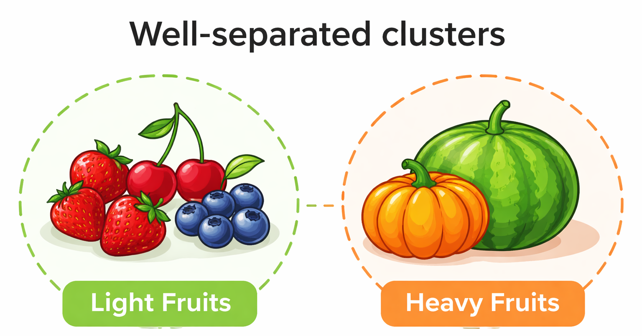
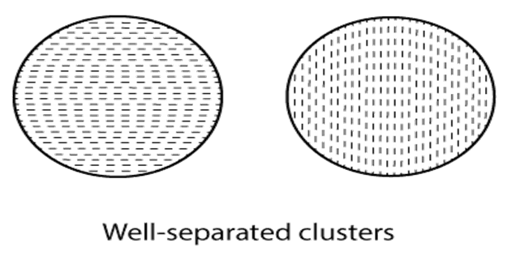
Types of clusters
Well separated cluster
The data object within a cluster must have small distance and distance between two cluster must be high.

Slide 38
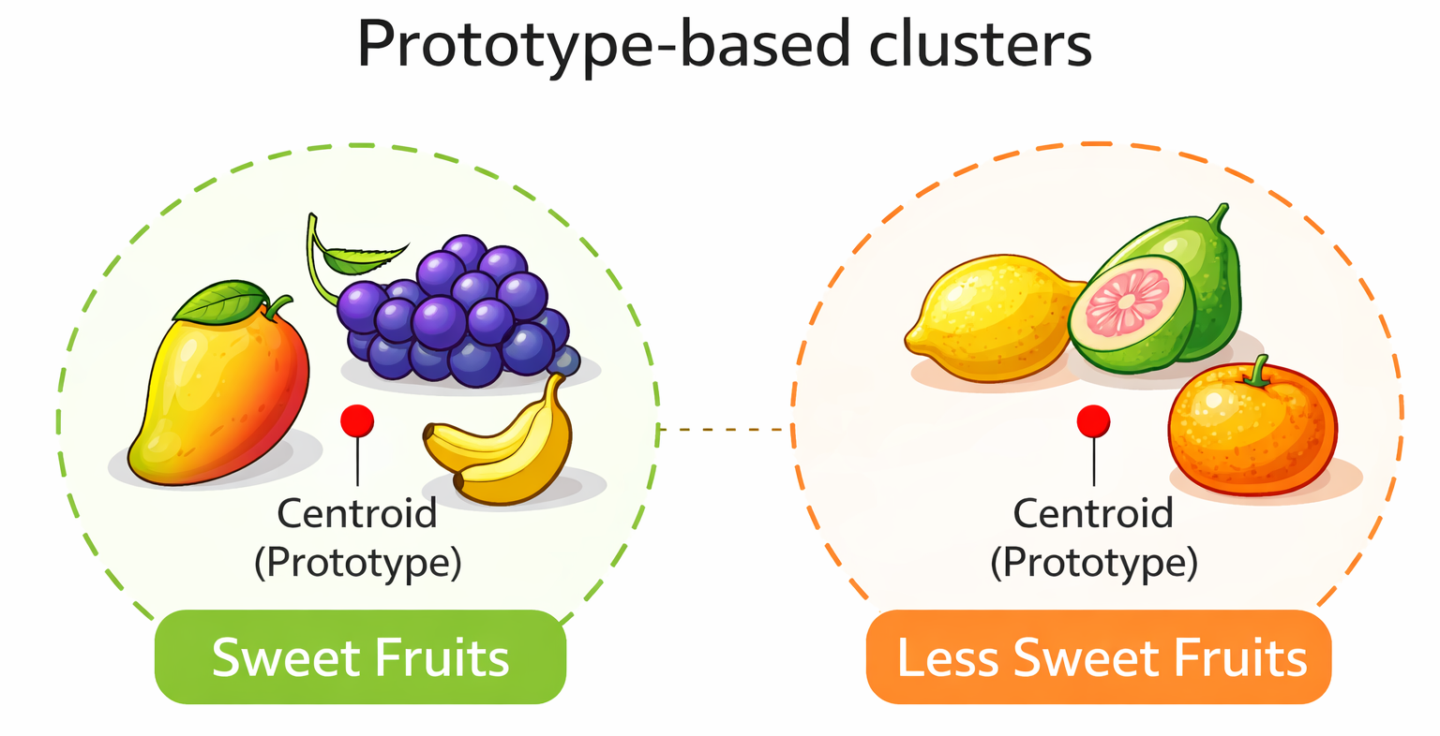
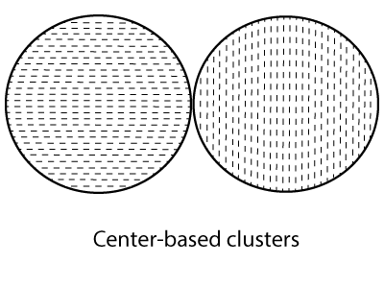
2. Prototype based cluster(centre based cluster)
Each object is closer(similar) to the prototype that define the cluster than to the prototype of any other cluster

Slide 39
3. Graph based cluster(contiguity based)
Two objects are connected only if they are within a specified distance of each other.
· Each point in a cluster is closer to at least one point in the same cluster than to any point in a different cluster.
· Useful when clusters are irregular and intertwined.
· This does not work efficiently when there is noise in the data, a small bridge of points can merge two distinct clusters into one.

Slide 40
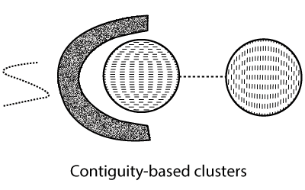
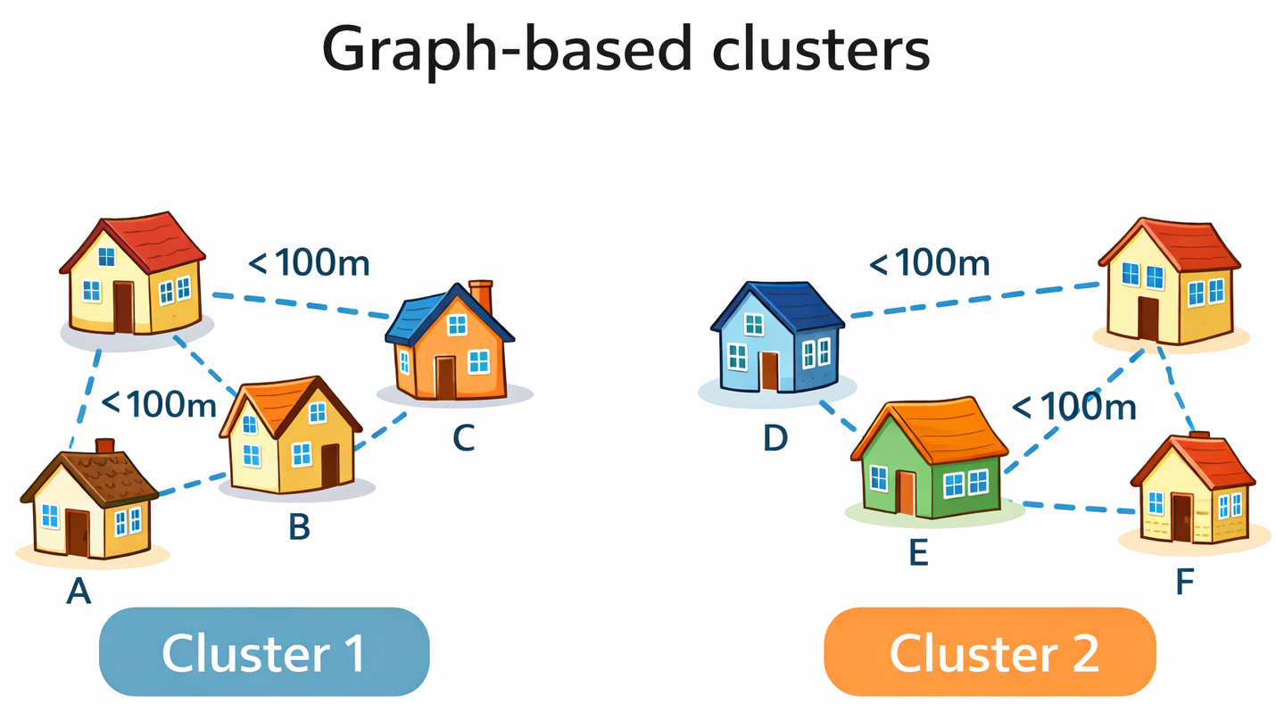

Slide 41
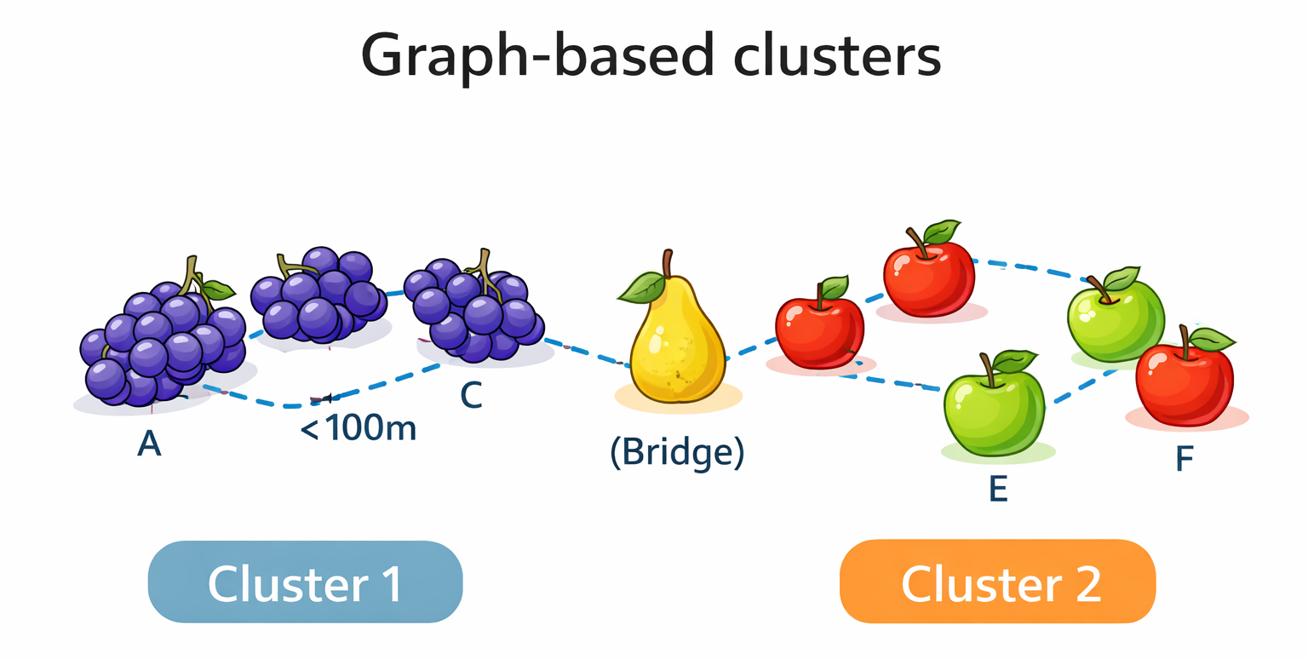
Example 2

Slide 42
Density Based Clusters:
Cluster is a dense region of objects that is surrounded by a region of low density.
Density based clusters are employed when the clusters are irregular, intertwined and when noise and outliers are present.
Points in low density region are classified as noise and omitted.

Slide 43

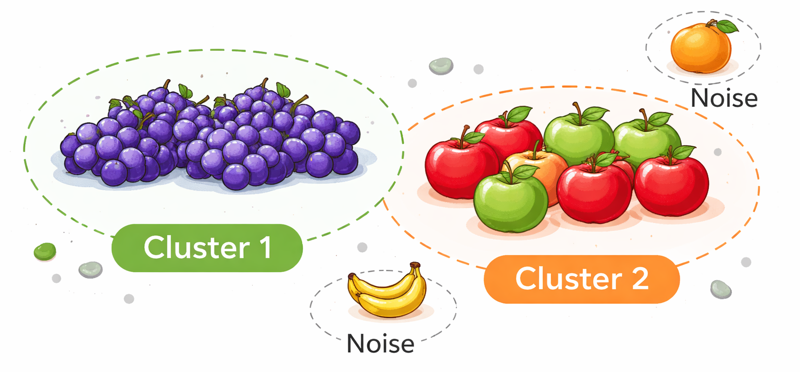

Slide 44
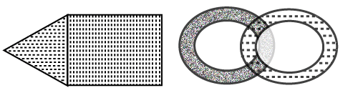
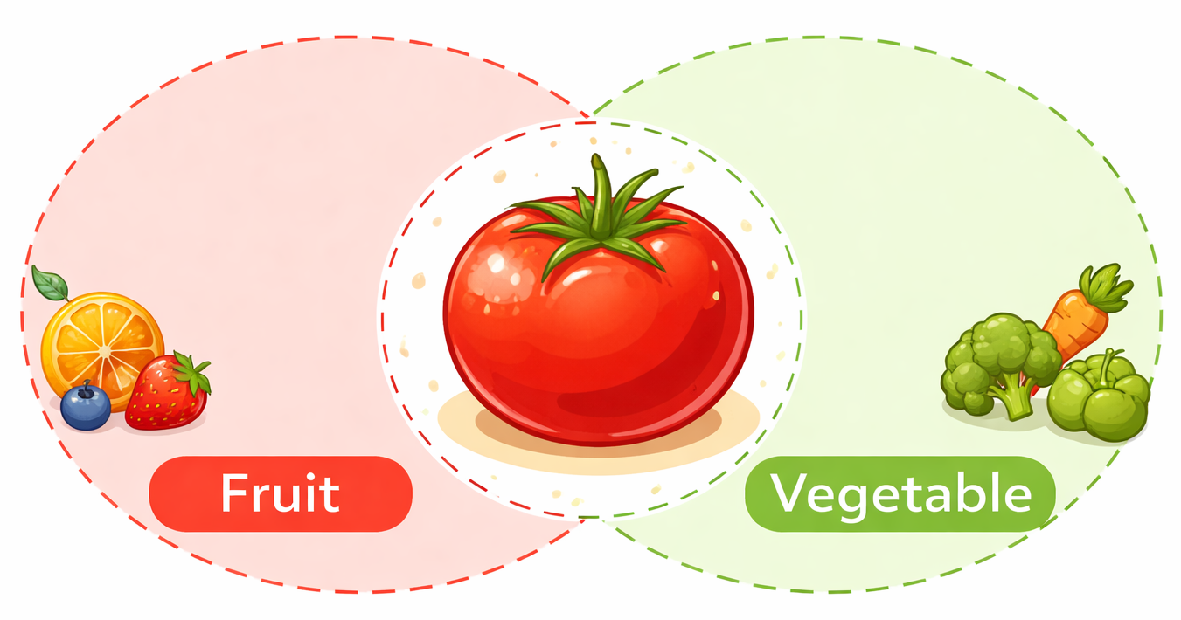
Shared Property cluster(Conceptual cluster)
More general
Set of object that share same property

Slide 48
DBSCAN Algorithm
Label all the points as core, border and noise
Eliminate noise points
Put an edge between all the core points that are within Eps
Make each group of connected core points to separate cluster
Assign each border point to one of the cluster of its Associated core points

Slide 49
Strength and weakness
It is resistant to noise
Can handle cluster of arbitrary shapes and sizes
It has trouble with high dimensional data because density is more difficult to define for such data
DBSCAN can be expensive when the computation of nearest neighbor requires computing all pairwise proximities

Slide 50
Agglomerative Hierarchical clustering
There are two basic approaches for generating a hierarchical clustering
Agglomerative
Divisive

Slide 51
Agglomerative:
Start with a point as an individual cluster and at each step, merge the closest pair of clusters
Divisive:
Start with one all inclusive cluster and at each step split a cluster until only a singleton cluster of individual parts remains

Slide 52
Agglomerative hierarchical clustering Algorithm:
Compute the proximity matrix, if necessary
repeat
merge the closest two clusters
update the proximity matrix to reflect the proximity between the new cluster and the original cluster
until only one cluster remains

Slide 53
Defining proximity between the clusters:
The different proximity measures in agglomerative clustering are:
MIN
MAX
Group Average

Slide 54
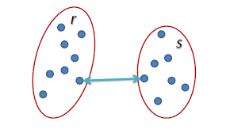
MIN defines the Proximity between the closest two points that are in different clusters

Slide 55
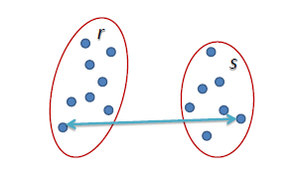
MAX defines the Proximity between the farthest two points that are in different clusters

Slide 56
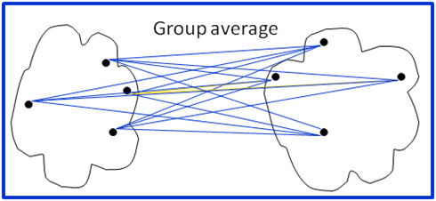
Group Average defines the cluster proximity to be the average pairwise proximities of all pair of points from different clusters

Slide 57
Strengths and weaknesses
Agglomerative algorithm can produce better quality clusters
Agglomerative algorithm are expensive in terms of their computation and storage requirement
All merge can cause trouble to noise in high dimension data such as document data

Slide 58
DBSCAN
Density based Spatial clustering Applications with noise
DBSCAN is based on centre based approach
In centre based approach, density is estimated for a particular points in a data set by counting the number of points within a specified radius of that point

Slide 59
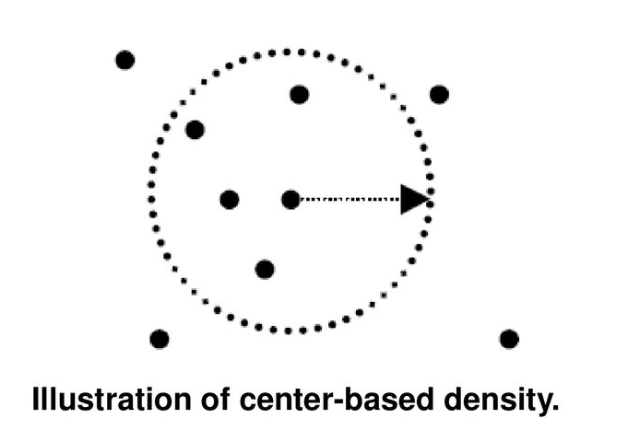

Slide 60
Classification of points according to centre based approaches:
This approach allows us to classify the points into following categories:
Core point
Border point
Noise or Background point

Slide 61
Core points are in the interior points of a density based cluster
Border points is not a core point but falls within the neighbourhood of the core point
Noise point is any point that is neither a core point nor a border point

Slide 62
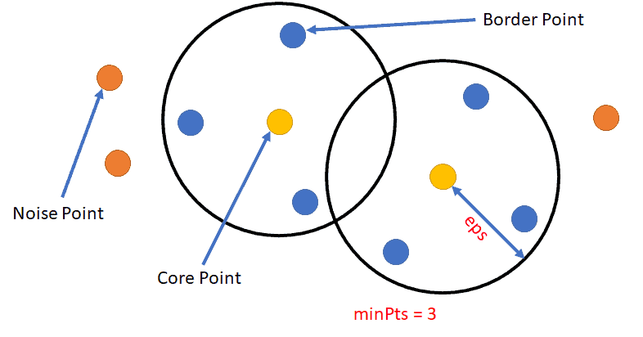

Slide 63
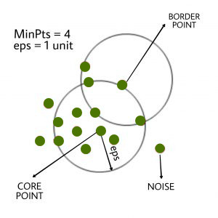

Slide 64
Grid based cluster
Breaks the data space into grid cells and then forms cluster from cells that are sufficiently dense

Slide 65
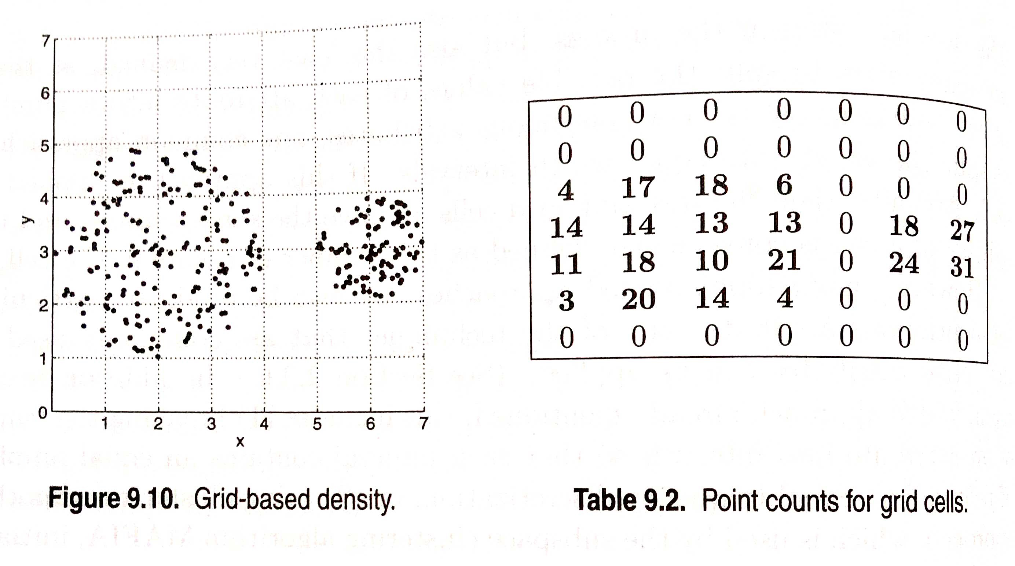

Slide 66
Subspace clustering
A technique which finds clusters within different subspaces.

Slide 67
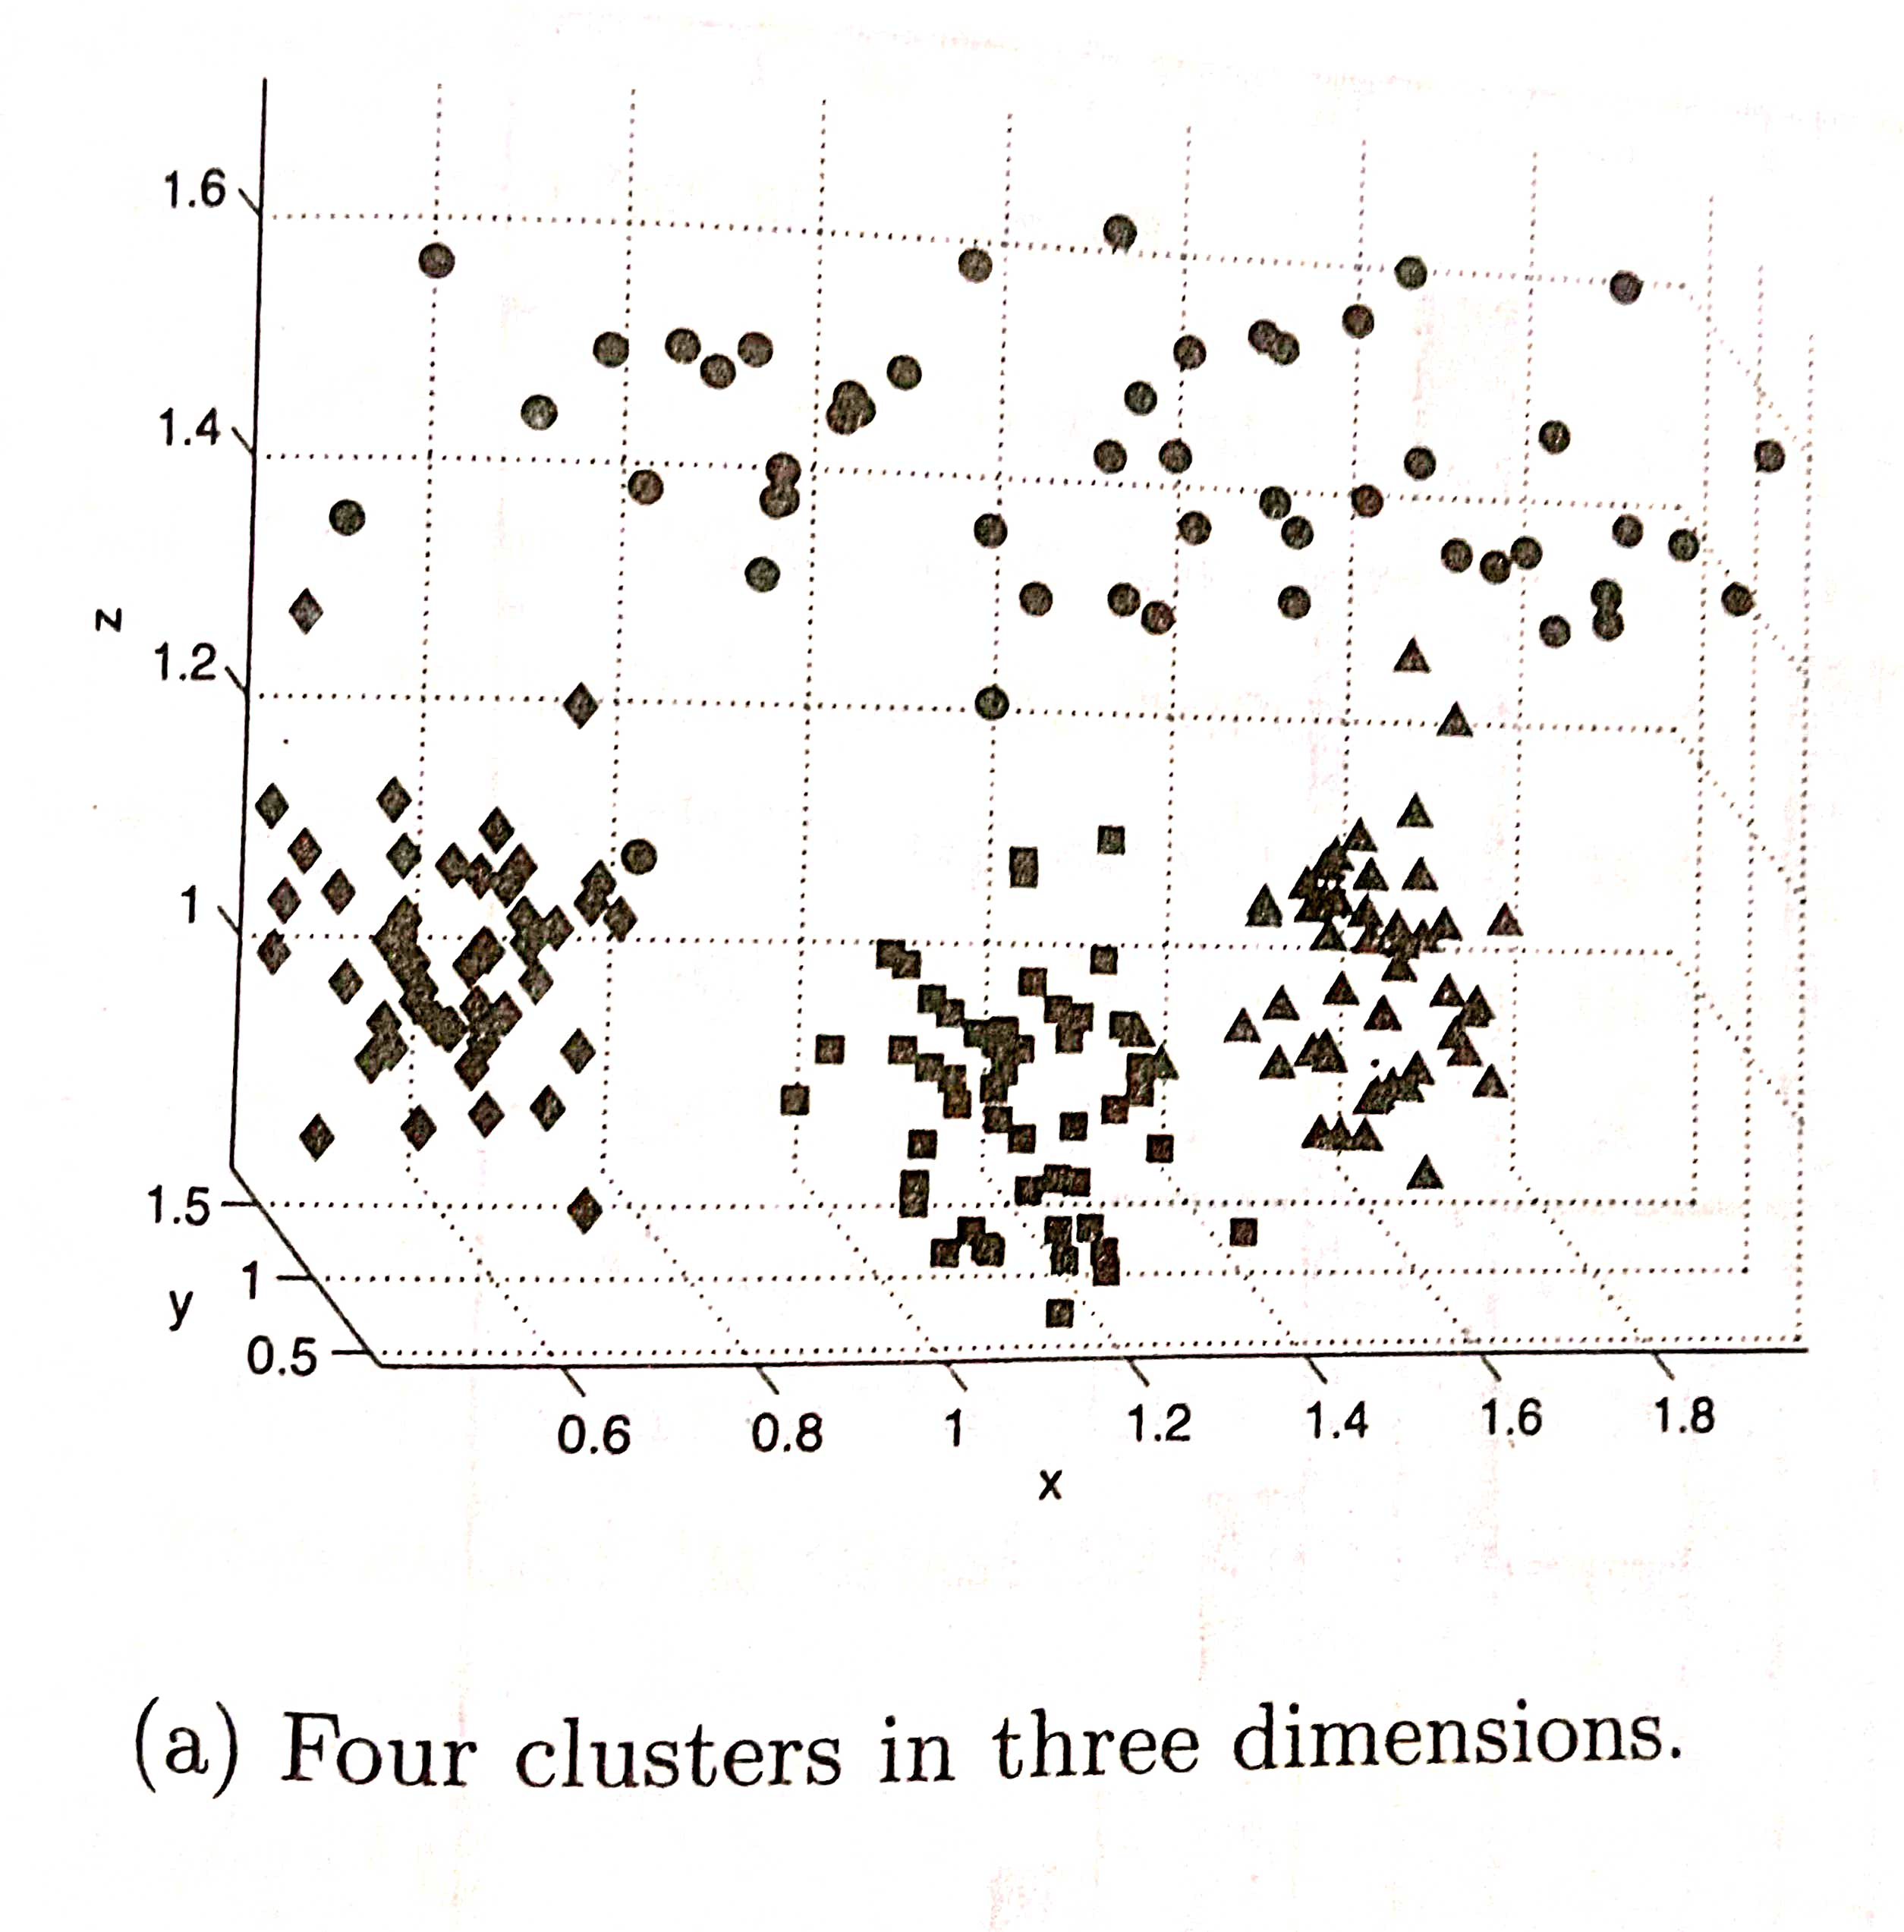

Slide 68
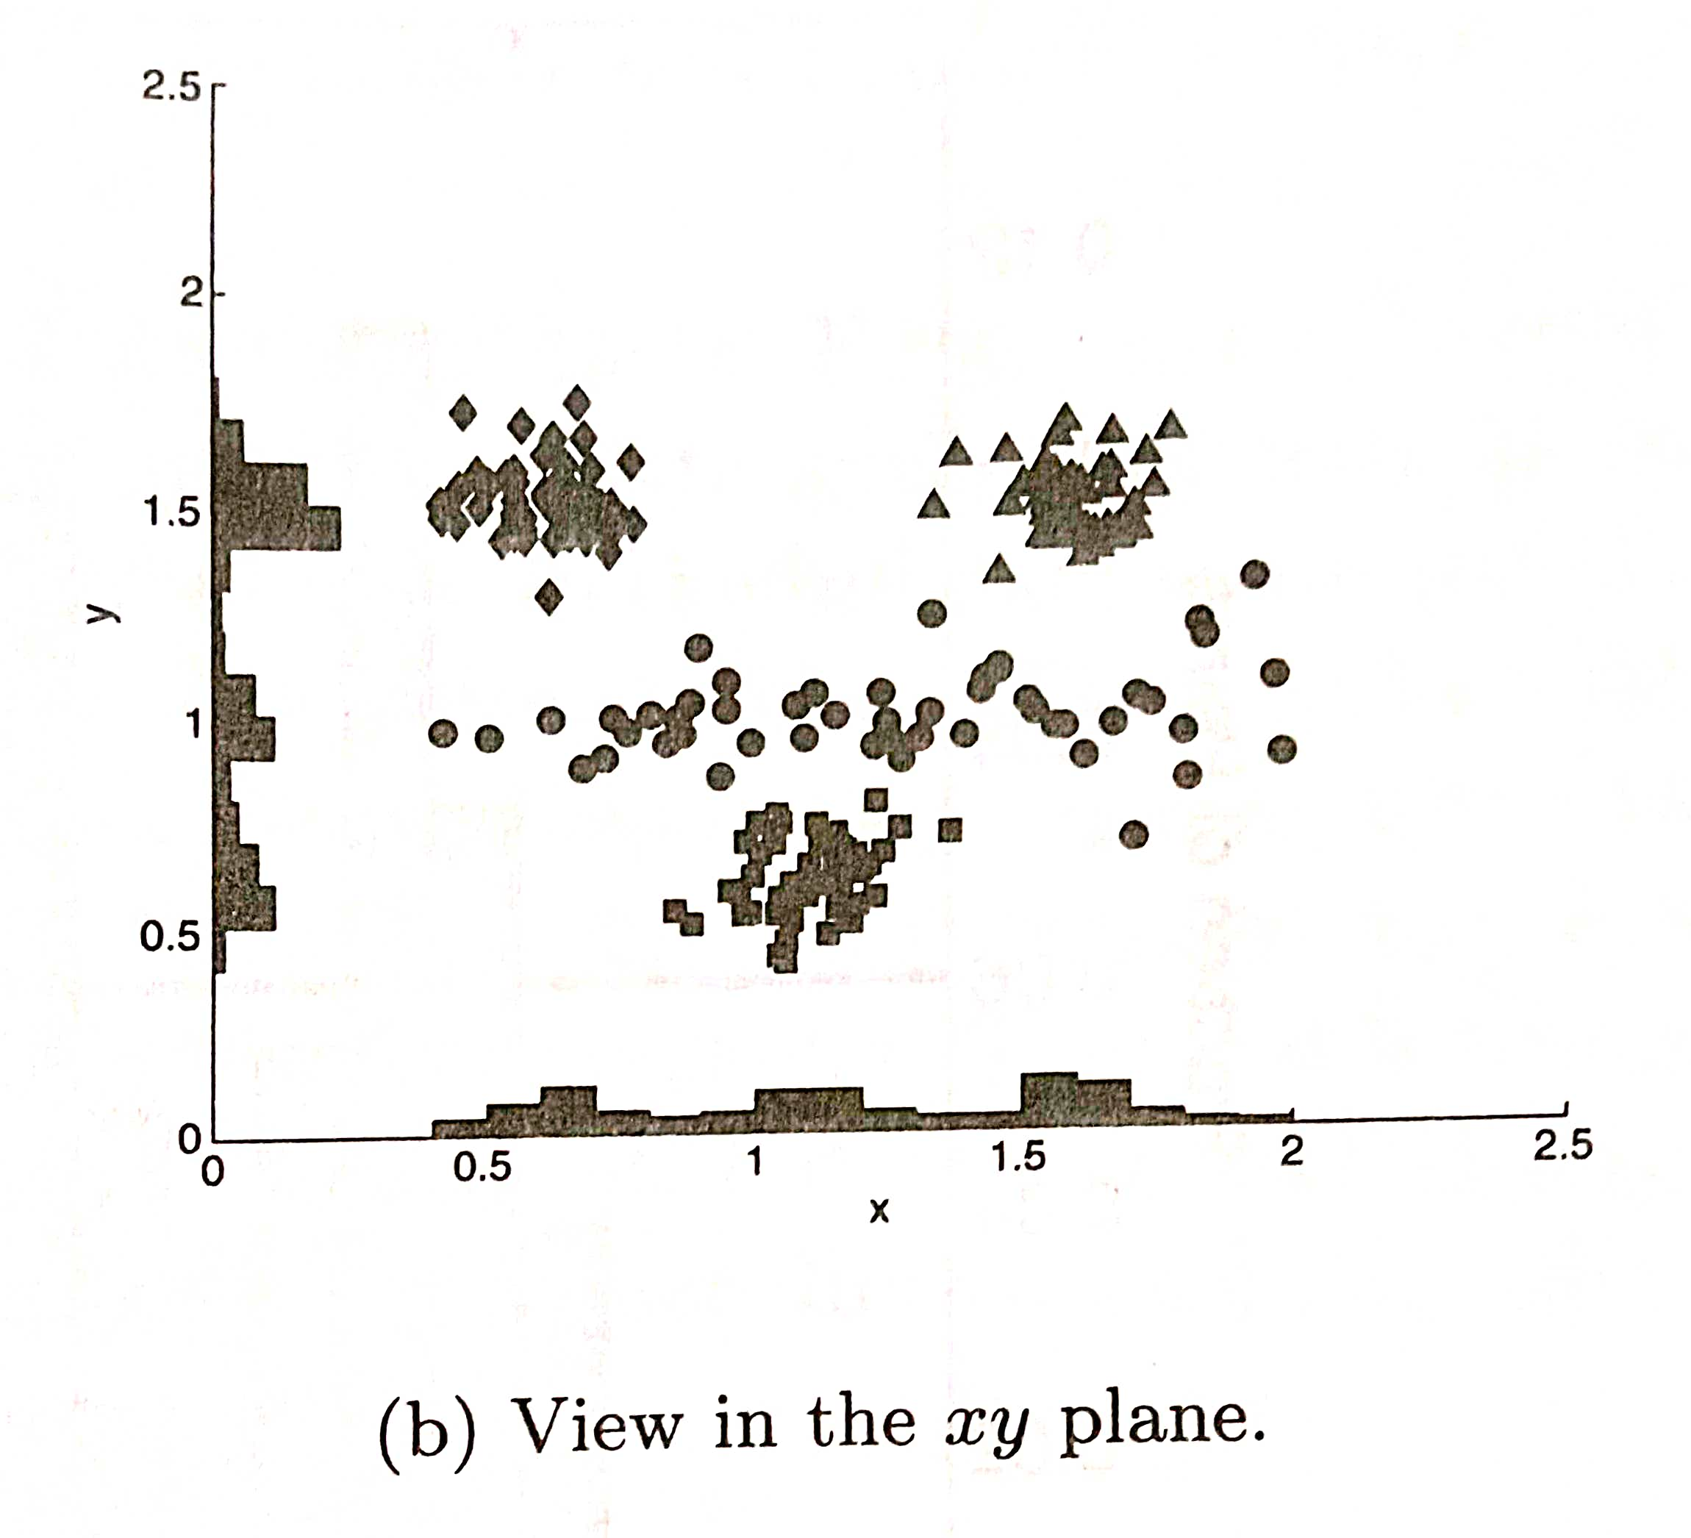

Slide 69
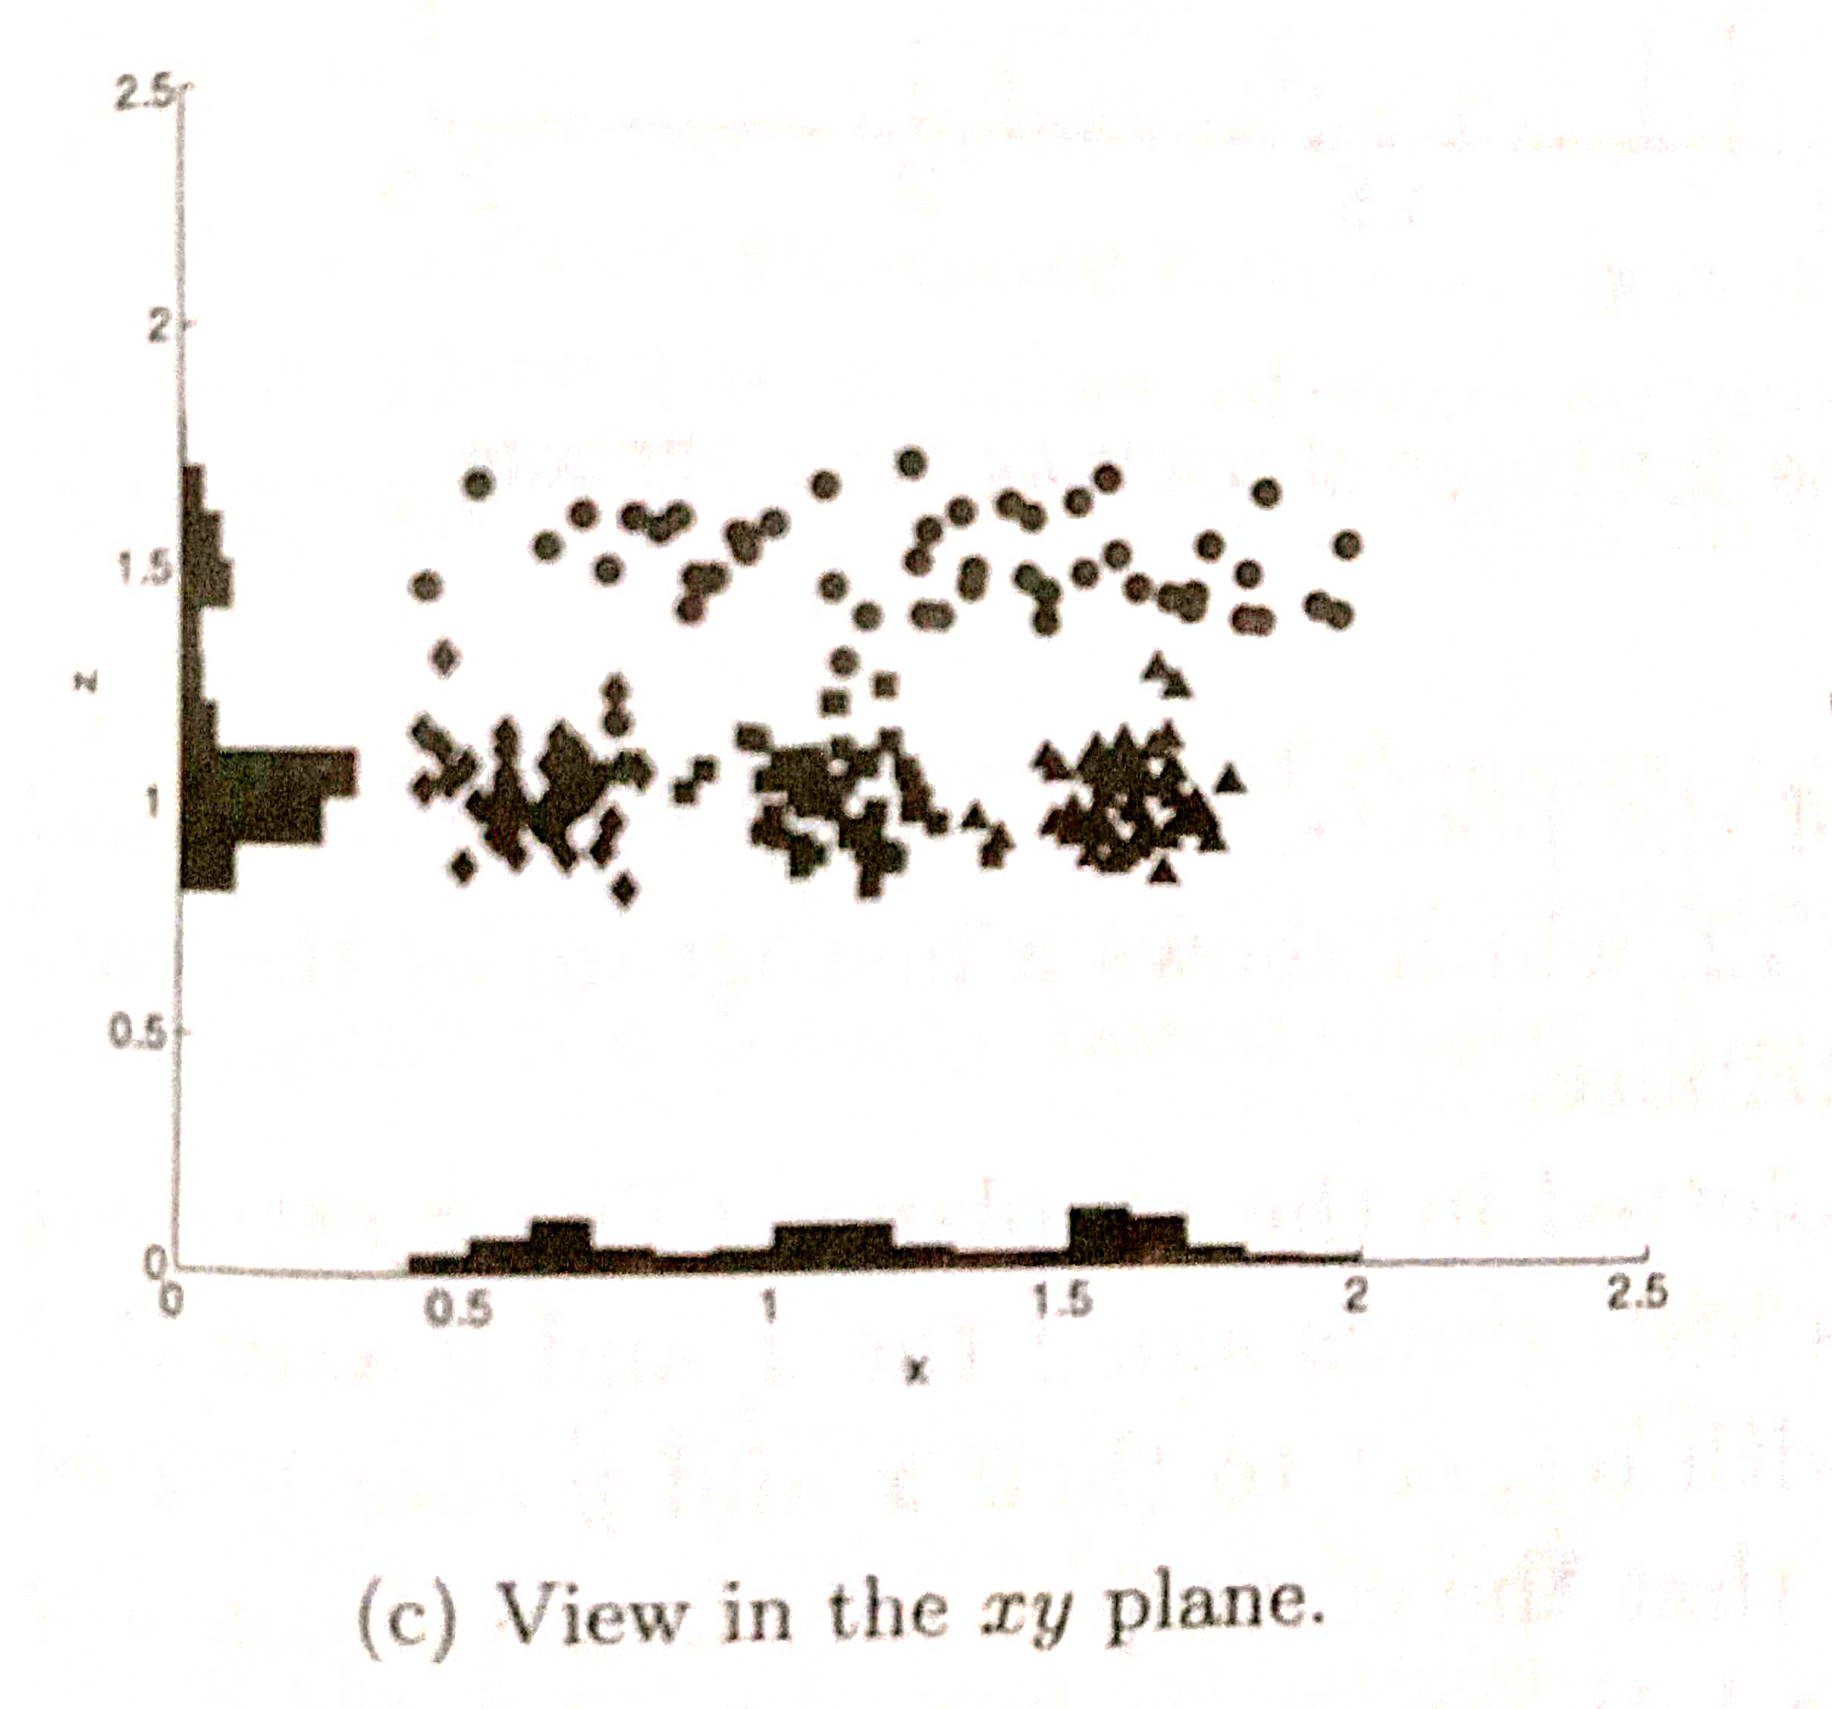

Slide 70
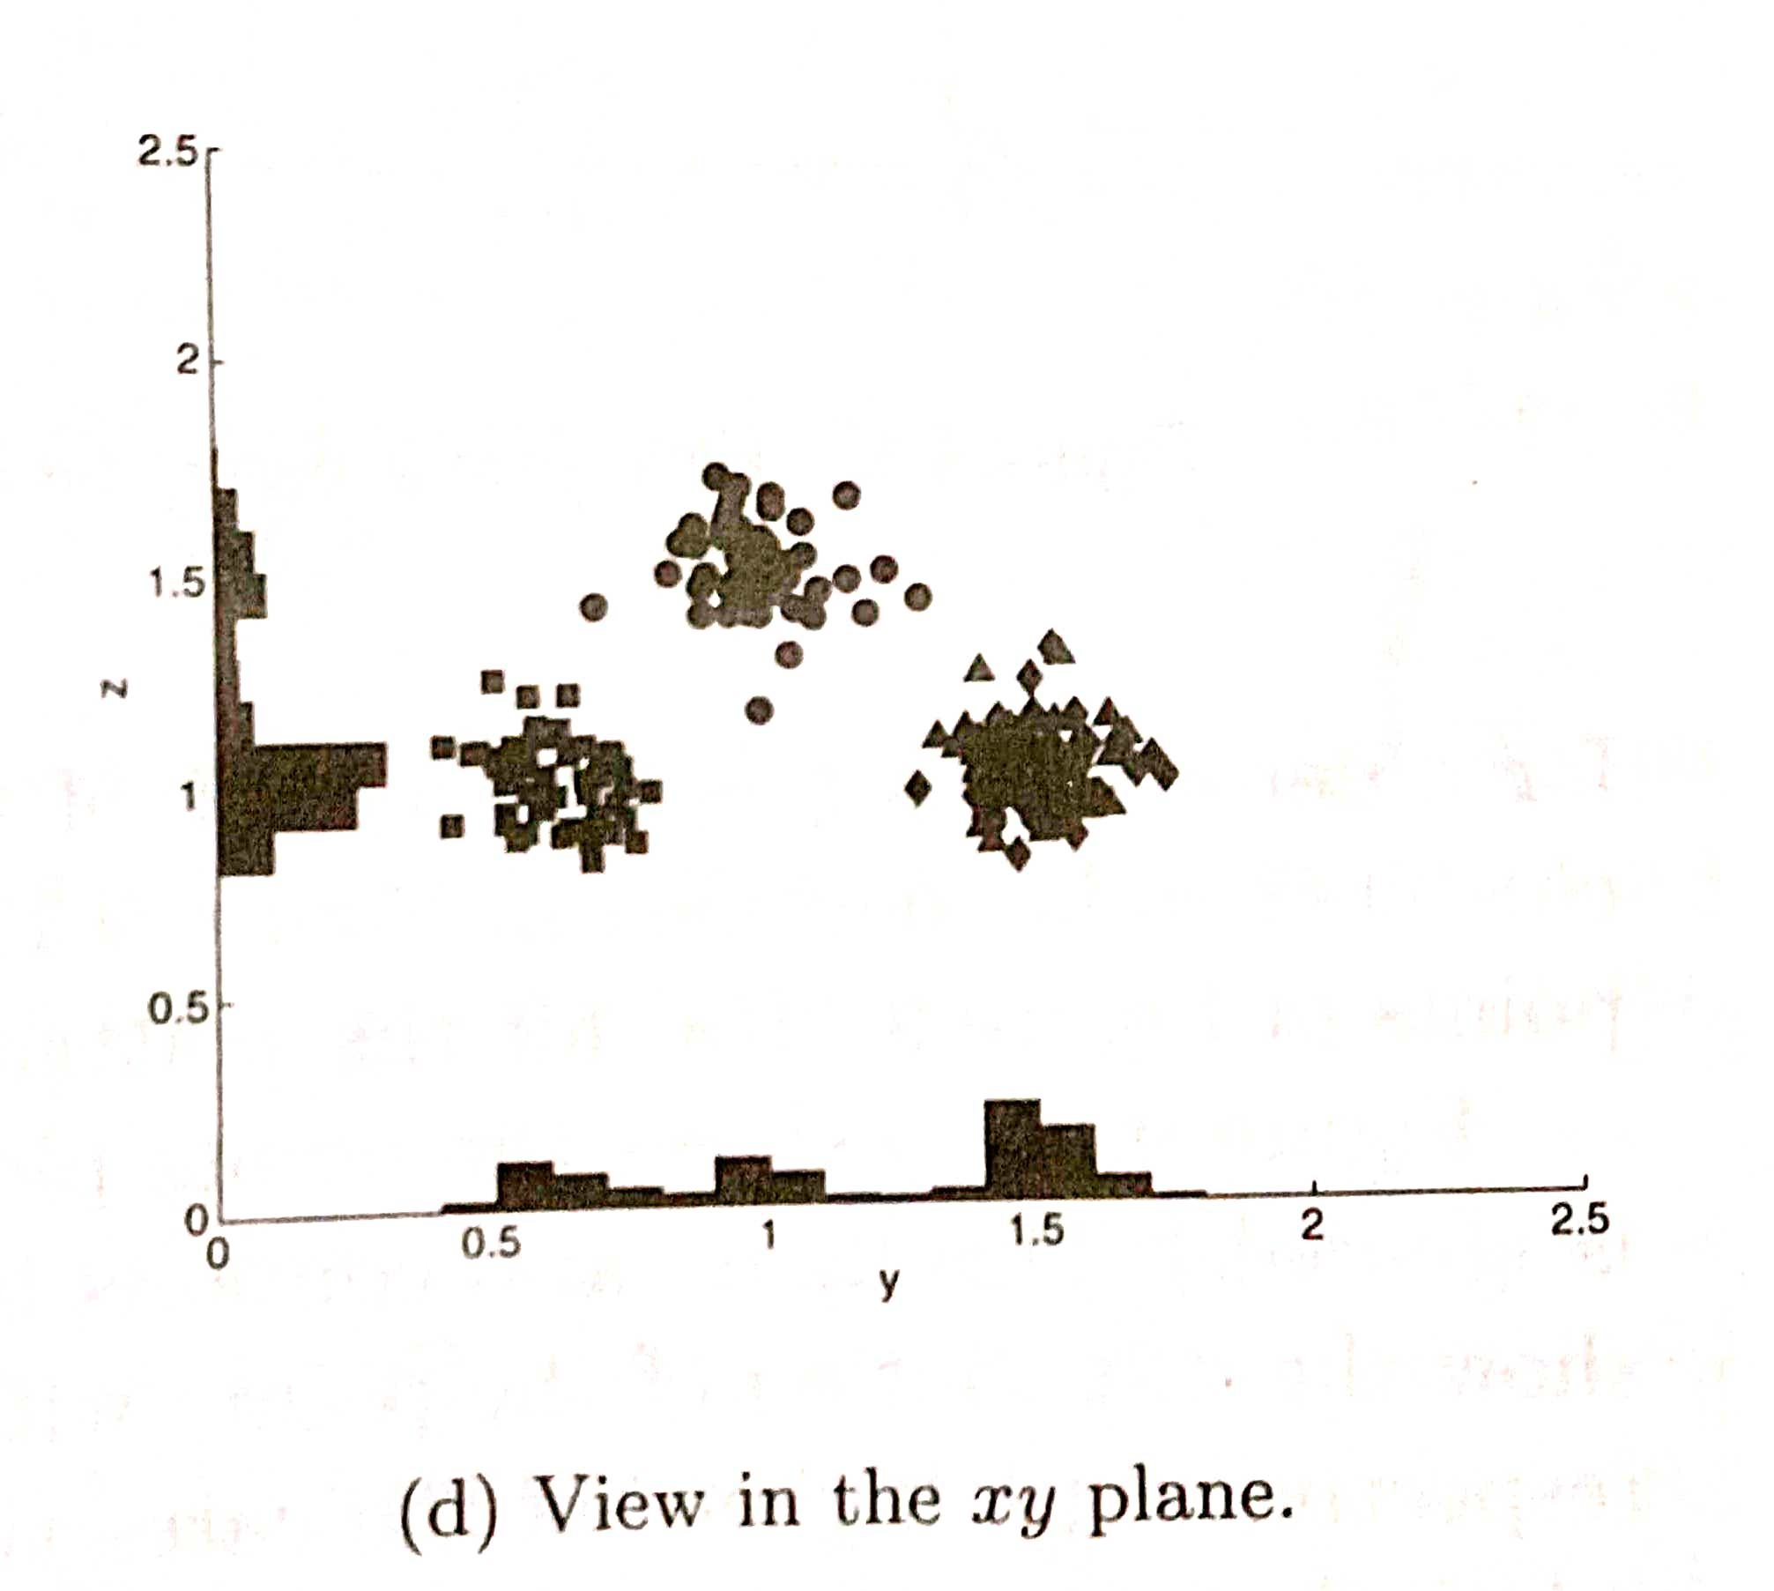

Slide 71
Cluster Evaluation
Cluster Evaluation should be a part of any of the Cluster Analysis
Cluster evaluation/Validation are traditionally classified into following types:
Unsupervised cluster Evaluation
Supervised cluster Evaluation

Slide 72
Unsupervised cluster Evaluation
Measure the goodness of the clustering structure without considering external information
Unsupervised measure is further divided into two classes:
Measure of cluster cohesion
Measure of cluster separation

Slide 73
Cluster cohesion determines how closely related to objects in a cluster
Cluster separation determines how distinct or well separated a cluster is from other clusters

Slide 74
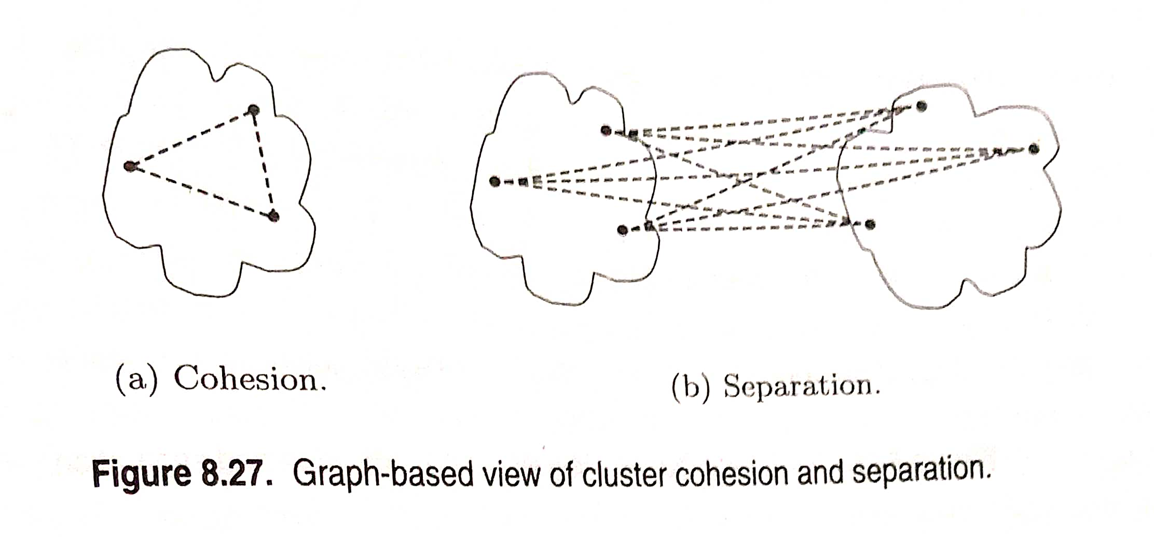

Slide 75
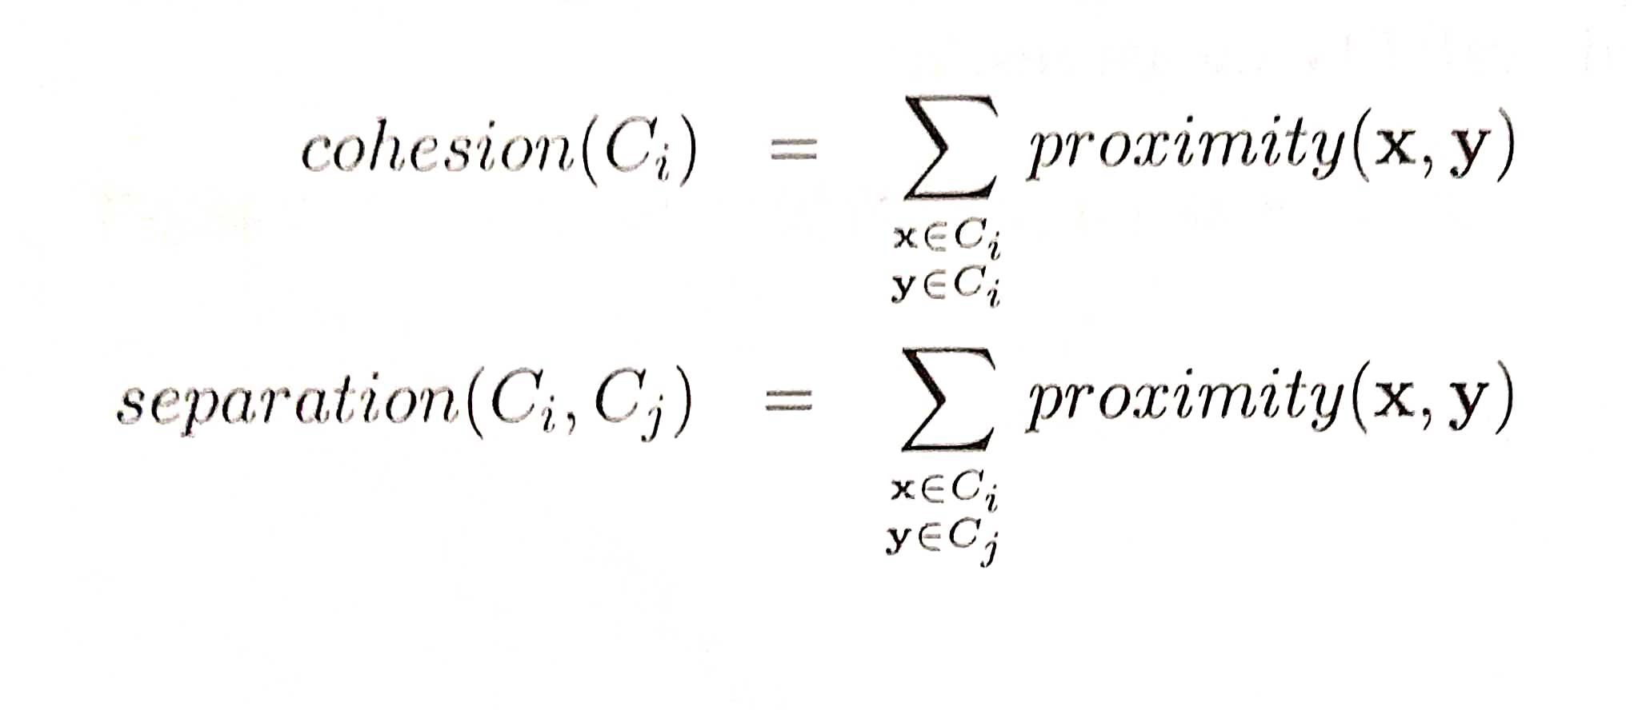
Cohesion and separation can be expressed using following equation:

Slide 76
Supervised cluster Evaluation
This approach measures the extent to which two objects that are in the same class are in the same cluster and vice versa
There are two types of supervised measures:
Classification oriented
Similarity oriented

Slide 77
Classification oriented
No. of measures such as “Entropy”, “Purity”, “Precision”, “Recall”, “F measure” are commonly used to evaluate the performance

Slide 78
Entropy:
The degree to which each cluster consists of objects of a single class

Slide 79
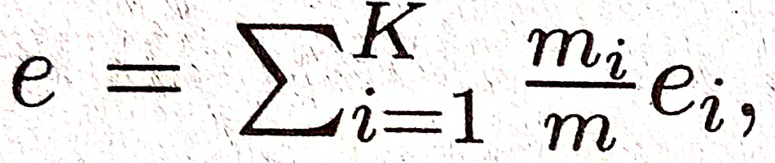
where K is the number of clusters
m is the total number of data points

Slide 80
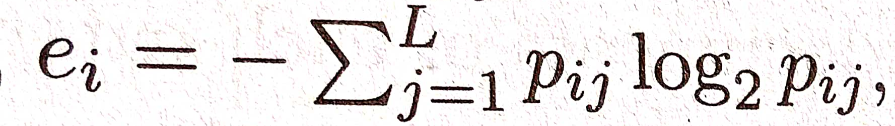
pij=mij/mi
where mi is the number of objects in cluster i
mij is the no of objects of class j in cluster i
L is the number of classes

Slide 81
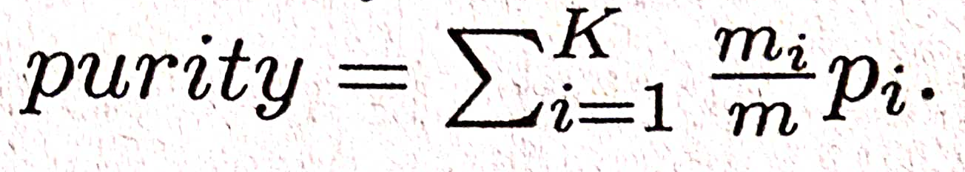
Purity:
where pi= max pij

Slide 82
Precision:
The fraction of a cluster that consists of objects of a specified class
precision(i,j)=pij

Slide 83
Recall
The extent to which a cluster contains all the classes
F measure:
combination of both precision and recall

Slide 84
Similarity oriented
Cluster evaluation will be done using comparison of two matrices
Ideal cluster similarity matrix
Ideal class similarity matrix

Slide 85
Ideal cluster similarity matrix
Has 1 in ijth entry if two objects i and j are in the same cluster, and 0 otherwise
Ideal class similarity matrix
Has 1 in ijth entry if two objects i and j belong to the same class, and 0 otherwise

Slide 86
